Slide 1
Achieving Better Resource Scheduling through Enhanced OS and ML Technologies
Lei Liu
Sys-Inventor Lab, SKLCA, ICT, CAS

Slide 2
Executive Summary
The technical evolutions for memory partitioning approaches.
Hybrid memory management in OS for systems using NVM-DRAM.
Next Generation OS - Leveraging ML to build resource scheduling mechanisms.

Slide 3
Topic 1: Memory partitioning mechanism

Slide 4
Organization of Shared Memory System More cores share the memory system; main memory B/W is still the bottleneck
Core 0
Core 1
Core 2
Core N
...
Shared Memory System
Shared Cache
Memory Controller
On-chip
Chip Boundary
Off-chip
DRAM
Bank 0
DRAM
Bank 1
DRAM Bank 2
...
DRAM Bank K
Notes:
Today’s server has several cores on die, they share the LLC, memory controller, bandwidth, and the off-chip DRAM banks. Our study focus on the Shared memory system.
-----------
In modern computer system, the core number in a single die is still increasing. They share last level cache and memory controller and the bandwidth. They are on-chip components,
Main memory system consists of server DRAM banks, and they are shared by all cores. The banks, shared last level cache resource and memory controller are called shared memory system.

Slide 5
Interferences on DRAM Banks Threads suffer from Row-Buffer Conflicts
Row-Buffer Conflicts
Row-Buffer
2 times Thrashing of Row 1: increases latency
Bank
Memory Latency = N*tRC (Caused by Row-Buffer Thrashing) + I/O Latency
Row-Buffer Conflicts might limit the bandwidth utilization
Notes:
Because dram banks are shared by applications, the memory requests from them go to a specific dram bank will definitely incur row-buffer conflicts.
This is an example to show the row-buffer thrashing caused by conflicts. Different color means different memory requests from different threads.
This will incur 2 times thrashing of Row 1, and thus increase memory latency.
Memory latency is equal to N times tRC plus memory I/O latency, where n is the times of row-buffer thrashing , and tRC is its time cost.
----------------
<begin>
Because DRAM BANKS are shared among threads. if several applications are running together, Interference on banks is always a serious problem.
If memory requests go to the different row in the same bank, they have to be moved to the row-buffer one by one, and served one after another. This is so called row-buffer conflicts.
</>
1….2….3…

Slide 6
The Performance Lost -- Caused by Inter-thread Interferences
Shared cache^{[Zhuravlev+,ASPLOS10]}
50% performance degradation
Shared DRAM^{[Moscibroda+,Security06, Onur]}
Unfair: 1.09x v.s. 11.35x
System slowdown: 2.9x v.s. 6x
Impact Overall System Performance and QoS Seriously!
Our Solutions – Partition memory resources among threads, reducing DRAM bank-level memory conflicts.
Notes:
The memory interference will lead to performance lost. Many study show that it will impact the overall system performance and QoS seriously.
Many studies try to address this problem.

Slide 7
Partitioning Banks into Groups
Banks are partitioned into groups
Thread 1
Thread 2
Thread 3
DRAM Banks
How to achieve this goal? – Relying on the OS
Notes:
This is our goal. Dram banks are colored into different groups. And , it is forbidden that one thread with different color to access other thread’s memory.
Thus, the interferences between threads are eliminated.
But one may raise a question: whether reducing the available amount of banks that one thread can access will impact the performance?
---------
By this partitioning approach, banks are divided into diff. colored groups. Thread can only access its corresponding colored banks, which are assigned at the beginning.
It is forbidden to banks be of other color, which do not belong to it. Apparently, we forbid the all banks across interleaving. It will raise another question, will the limited number of banks impact the overall system performance?
---------
To this end, we have made 2 key observations that lead to our new mechanism design

Slide 8
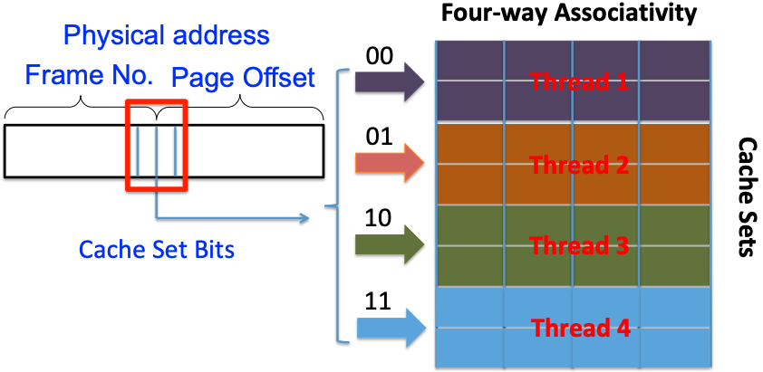
Bank bits in PFN
Some bits in Page Frame Number (PFN) denotes the bank address
Extend Page-Coloring to partition banks
DRAM Banks
Notes:
Our study shows that there are some bits in page frame number denote the bank address. And thus, we are able to leverage these bits, and extend page coloring to partition dram banks among threads.
--------------
The same reason, there are also some bits denote the bank address. So that it inspire us that we could extend page-coloring to partition DRAM banks.
To this end, we have made 2 key observations that lead to our new mechanism design

Slide 9
DRAM banks are colored according to bank bits in PFN
Banks are colored into diff. groups
Thread 1
Thread 2
Thread 3
DRAM Banks
Reducing the available amount of banks that one thread can access
Notes:
This is our goal. Dram banks are colored into different groups. And , it is forbidden that one thread with different color to access other thread’s memory.
Thus, the interferences between threads are eliminated.
But one may raise a question: whether reducing the available amount of banks that one thread can access will impact the performance?
---------
By this partitioning approach, banks are divided into diff. colored groups. Thread can only access its corresponding colored banks, which are assigned at the beginning.
It is forbidden to banks be of other color, which do not belong to it. Apparently, we forbid the all banks across interleaving. It will raise another question, will the limited number of banks impact the overall system performance?
---------
To this end, we have made 2 key observations that lead to our new mechanism design

Slide 10
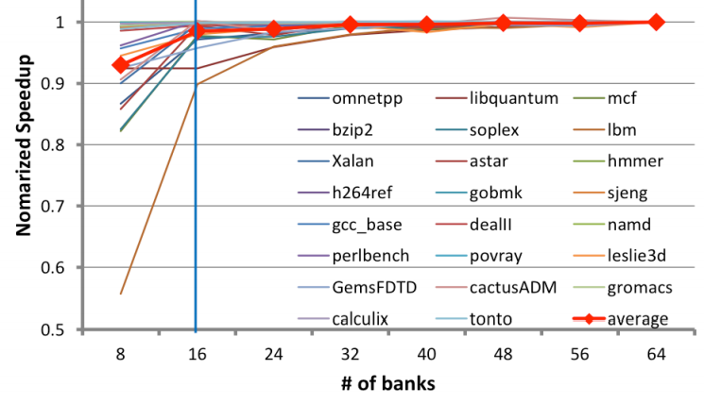
The necessary bank amount
Will this influence performance?
The necessary amount of banks one program
requires is limited, allocating more banks cannot bring more performance but the bank conflicts!
Notes:
we found that the necessary amount of banks that one program requires is limited.
And, 16 banks are enough for most applications. They can achieve over 95% of performance compared to 64 banks.
So it is feasible to partition banks into several groups and map bank groups to specific threads.
--------
But doing exclusively mapping would reduce the available bank amount for one thread. So we need to know whether it would affect application’s performance.
We did experiments on an Intel machine with 64 banks to investigate the correlation between bank number and applications’ performance. Surprisingly, we found that 16 banks are enough for most applications. They can achieve over 95% of performance compared to 64 banks.
So it is feasible to partition banks into several groups and exclusively map bank groups to specific threads.
But how?

Slide 11
Where do the benefits come from?
Notes:
This is the result of our system. With BPM, on average, the service time of memory system can be reduced.

Slide 12
Bank-level Partition Mechanism (BPM)
Implementation: adopt page-coloring base BPM in Linux kernel 2.6.32 by modifying its buddy system.
group free pages into 32 colors.
Adjust the page allocation algorithm in OS.
Notes:
We get the bank bits in typical machine,
We implement BPM into real linux kernel by modifying the buddy system.
------------------
……
We make change to buddy system in operating system very serious, and we adapt a efficient … algorithm, by which one thread can get its corresponding colored pages effectively.
and adjust the page allocation algorithm so that the thread can get the page with corresponding color efficiently and
effectively.
--------------------
So far, we’ve addressed the mapping challenge. Next, we implement the page-coloring based bank partition mechanism into a Linux kernel.
We modify the buddy system which manages free physical pages in kernel. We make the buddy system group free pages into 32 colors and use a new algorithm for page allocation.
We perform experiments on an Intel machine with 8GB DRAM and 64 banks. The benchmark is SPECCPU 2006 and PARSEC.

Slide 13
Experiment Environment
System Configuration
-- 4-core/8-thread Intel Core i7-860 CPU 2.8GHz
-- LLC: 8MB/16 ways of associativity
Memory Configuration
-- Micron DDR3-1333
-- 2 Channel, 8 Ranks, 64 Banks
Workloads
-- 23 benchmarks from SPEC CPU 2006 (Multi-Program)
-- PARSEC (Multi-Thread)
Notes:
We use real machine that has i7-860 2.8GHz and 8MB last level cache. The memory system is ddr3 dram with 2 channels, 8 ranks, and 64 banks in total.
We use spec 2006 for the multi-programmed workloads. And parsec for multi-threaded workloads.

Slide 14
Experimental Results BPM motivates many studies on the field of memory optimizations
System throughput: 4.7%↑ (up to 8.6%)
Maximum slowdown: 4.5%↓ (up to 15.8%)
Memory Power: 5.2% ↓
A Software Memory Partition Approach for Eliminating Bank Level Interferences (PACT-2012)
Notes:
Here are the overall results.
The first step experimental results show that …..
By using the software partition approach, we can achieve system throughput improvement by 4.7% on average and up to 8.6%. The maximum slowdown decreases by 4.5% and up to 15.8%. The approach can also save some memory power.
So this is our software bank-level partition work.

Slide 15
Extend BPM to BPM+ Memory accesses are scheduled across channels and banks
Reducing the Channel-level interferences
“blindly” interleaving
BPM+, memory accesses become more efficient
BPM/BPM+: Software-based Dynamic Memory Partitioning Mechanism (ACM TACO-2014)
Notes:
Our further work, extend BPM to BPM+, which can reduce the memory channel level interference.
This is the blindly interleaving scheme, and w/ bpm+, we let each thread use a specific channel, and bpm+ also partition memory at dram bank level.
The performance is from eliminating the bank level interferences and the mitigating channel level memory pressure.

Slide 16
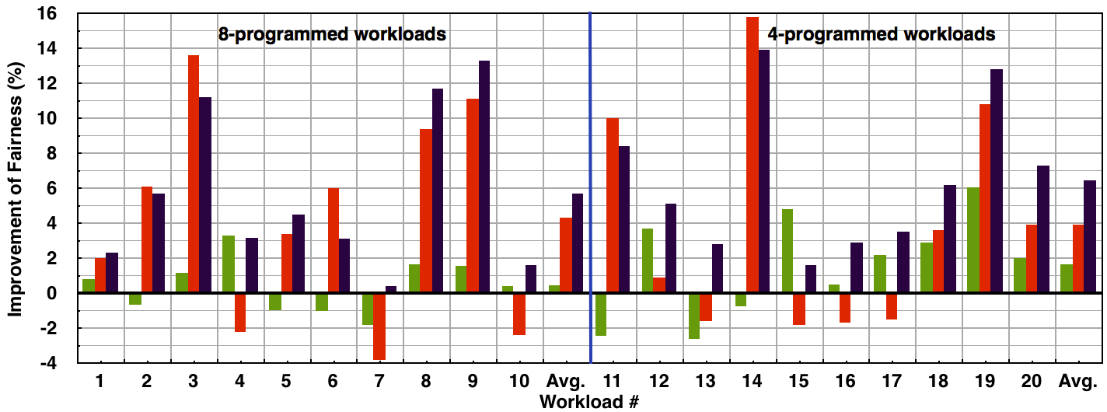
BPM+: Overall System Performance
Notes:
Compared with BPM, BPM+ further brings additional performance benefits.

Slide 17
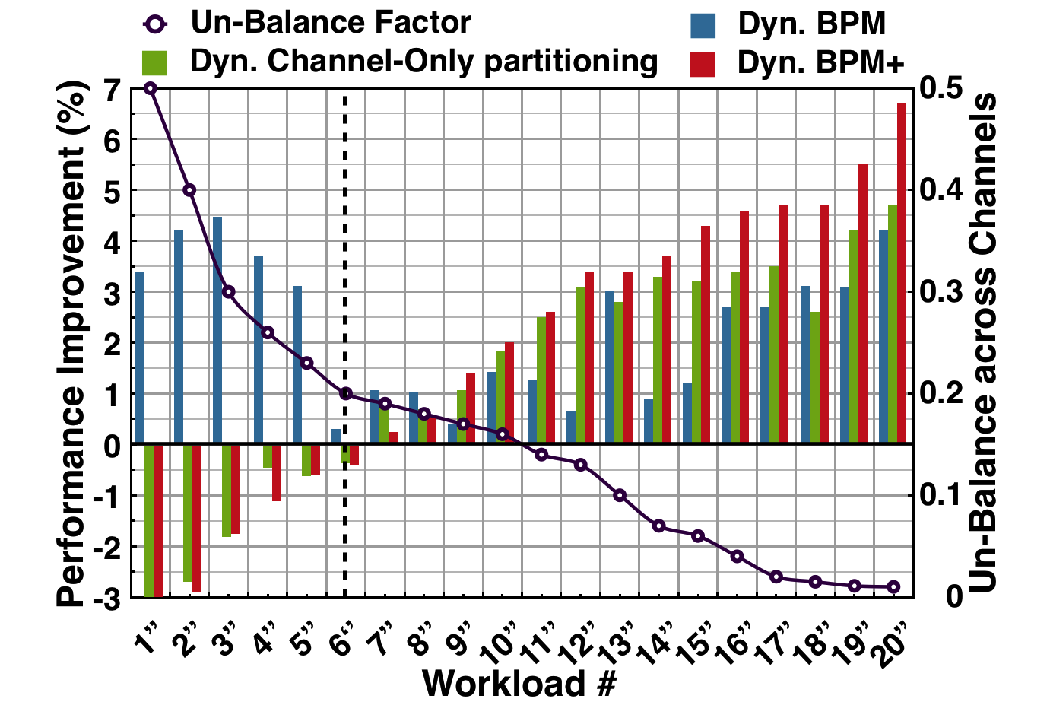
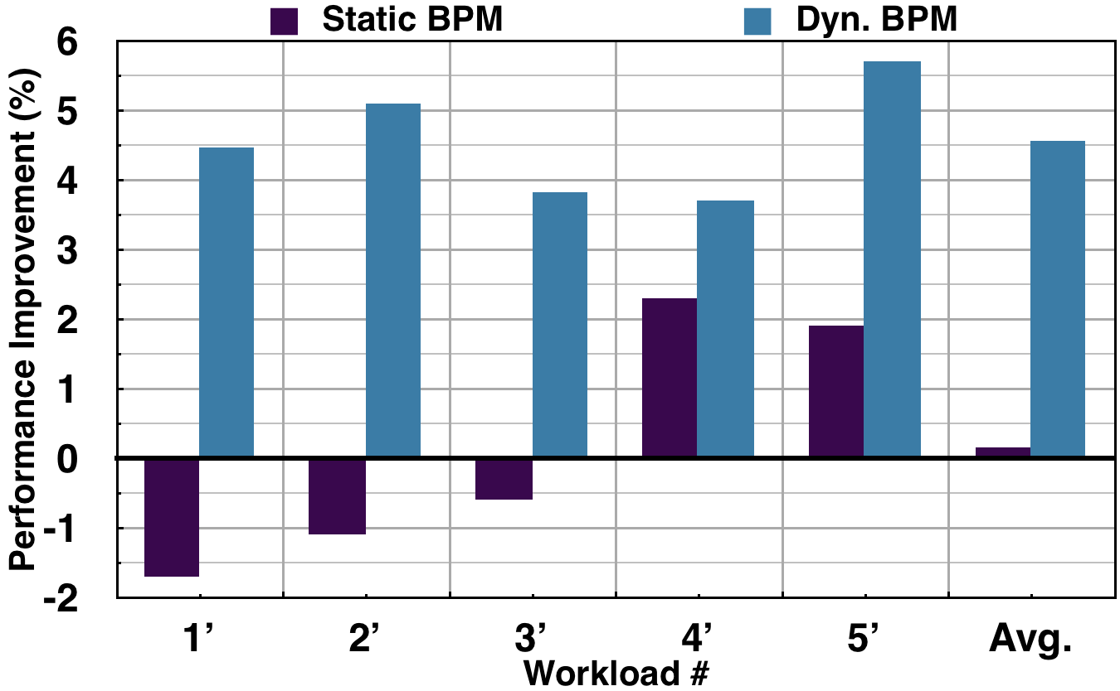
Memory Optimization Framework -- Supporting Dyn. and Flexible Scheduler
Notes:
Our mechanism is dynamic and flexible. You can develop new memory and process scheduler base on it.
For example, by using performance counter, we are able to develop a bandwidth-aware scheduler, which support dynamic memory partitioning.
----
Our mechanism framework supports dynamic optimizations. Using hardware performance counter, we can develop new memory schedulers to support diversity.

Slide 18
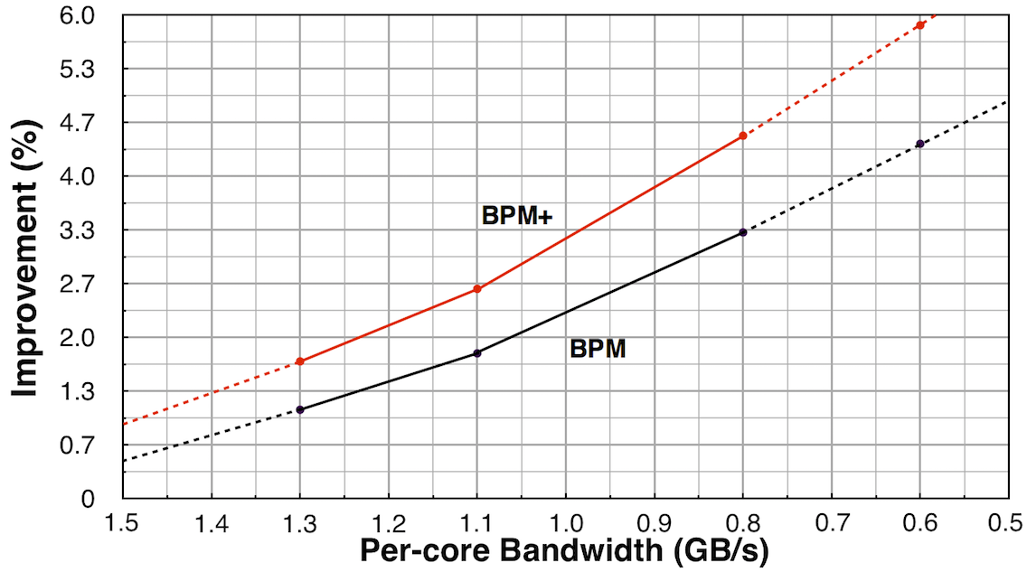
BPM/BPM+ and Per-core Bandwidth
BPM(+) is promising for future multi-/many-core platforms that have even less per-core bandwidth
Notes:
Bpm is promising for future multi-/many-core platforms. We conduct an experiment, with the decreasing of per-core bandwidth, bpm will be more effective.

Slide 19
In What We Win?
A practical software approach for eliminating Bank-level Interferences
-- Without any hardware modification to MC
-- Could be deployed on real system easily
-- Improves both fairness and system throughput
-- Saves energy consumption of memory system
Lei Liu et al. DRAM bank partitioning (BPM), PACT-2012
Lei Liu et al. BPM and BPM+, ACM TACO-2014
Notes:
Our goal is to ……
To this end,

Slide 20
Advanced Technical Evolutions: Hierarchically optimizing data placement across cache and main memory banks

Slide 21
Architecture Features on Modern Multicore Systems
B-/C-/O-Bits in Address Mapping
The address Mapping of Intel i7-860 w/ 8GB Memory
Notes:
We further investigate the physical address mapping in modern computer. we found the address bits can be classified into three categories, Bank bits, Cache bits, and O-bits respectively. The O-bits denote both DRAM Bank and Cache address. The is a concrete example of Intel commercial chip.

Slide 22
“Vertical” Partitioning using O-Bits
Cache Set
Cache Line
T1 T2 T3 T4
Last Level Cache
DRAM Banks
Using o-bits, we can vertically partition last cache and DRAM banks at the same time. We introduce the concept of “vertical partitioning”, since it can eliminate the memory interferences at both cache level and DRAM bank level at the same time.
Notes:
Using o-bits, we can vertically partition last cache and dram bank at the same time. We introduce the concept of vertical partitioning, since it can eliminate the memory interferences at both cache level and dram bank level at the same time.

Slide 23
The Evolutions of Page-Coloring
--Cross-layer Cooperative Vertical partitioning
Lei Liu et al. Going Vertical in Memory Management, ISCA-2014
Lei Liu et al. Rethinking Memory Management in Modern OS, IEEE TC-2016

Slide 24
The Performance Gains from Vertical Partitioning

Slide 25
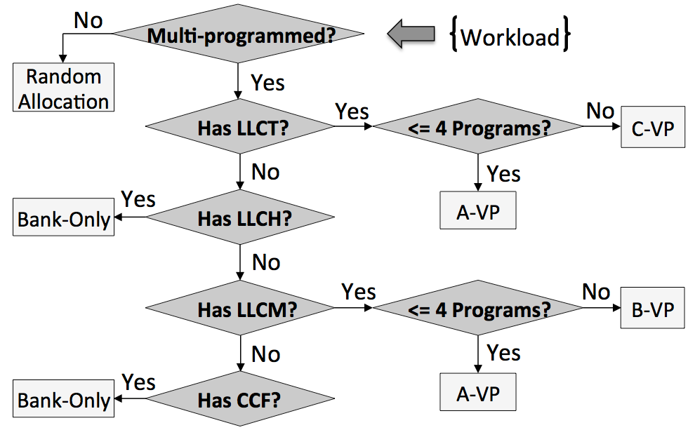
Handling Multiplicity by Multi-policy -- Memory Policy Decision Tree
We design a policy decision tree in Linux kernel, combining all of the memory allocation policies together, and the kernel enables right policies for workloads.

Slide 26
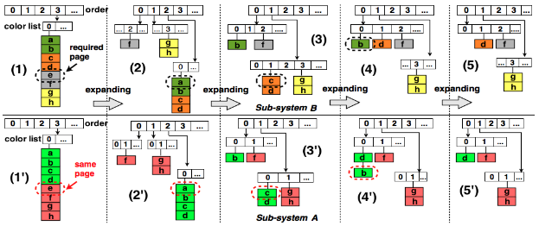
A Case in Practice on Customizing Buddy System in Linux Kernel @ Sys-Inventor Lab
A tiered buddy system, and each of them meets a specific memory allocation requirement. Two sub-buddy systems work cooperatively.
Lei Liu, et al, Going Vertical in Memory Management, In ACM/IEEE ISCA, 2014
Notes:
We used to customize the buddy system to achieve our specific target.
Through this slide, we would like to show a case in practice several yeas ago.

Slide 27
Optimizing the data mapping
Memory conflicts are reduced across memory hierarchy
Our System
Real World
App
OS
Arch.
Perf. Model
Sampling
App-Arch.-Aware Mapping
Linux OS
Decision
Resource Allocation
Allocation
Lei Liu et al. Going Vertical in Memory Management, ISCA-2014
Lei Liu et al. Rethinking Memory Management in Modern OS, IEEE TC-2016

Slide 28
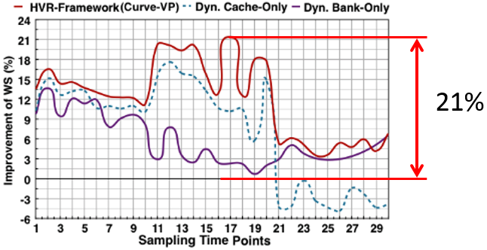
Overall Performance
Our system’s overall performance is positive. It outperforms the single level partitioning approaches, bringing 21% benefits to the unmodified kernel. More results can be found in our paper (ISCA-2014 and TC-2016).

Slide 29
Topic 2: Hybrid memory management in OS for systems using NVM-DRAM

Slide 30
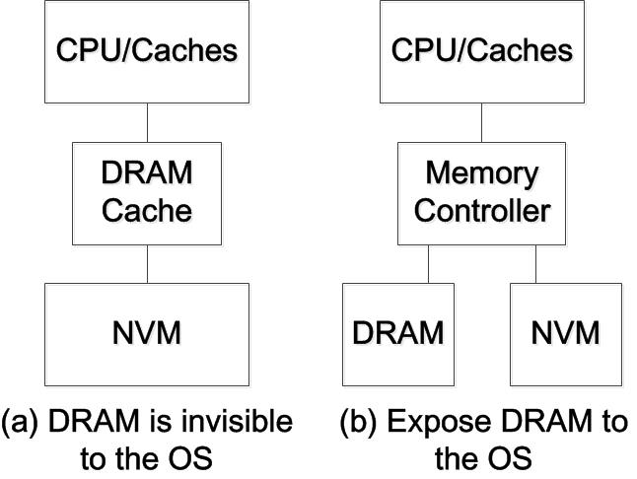
Hybrid Memory System
DRAM and NVM are in unified address space
Challenges (a) – Hardware architecture logics
Challenges (b) – Redesign the OS and runtime environments
- Data detecting/mapping and migrating
Notes:
In nowadays, NVM is involved in memory hierarchy. At present, NVM is placed below DRAM memory, or side by side with DRAM in an unified address memory space. For the first design, the challenges are hardware architecture design logics; For the second design, the challenges are redesigning the OS and runtime environments, including hot/cold data detecting, mapping and migration.

Slide 31
How Pages are Mapped between Memories -- HyMM: Hot Pages vs. Cold Pages
HyMM Can be used for diverse page grains.
Step 1
Step 2
Step1: Monitoring TLB misses to figure out the Hot regions in memory space;
Step2: Monitoring access_bit in PTEs for Cold regions to further check the pages classified as cold ones incorrectly.
HyMM: Hybrid Memory Monitoring

Slide 32
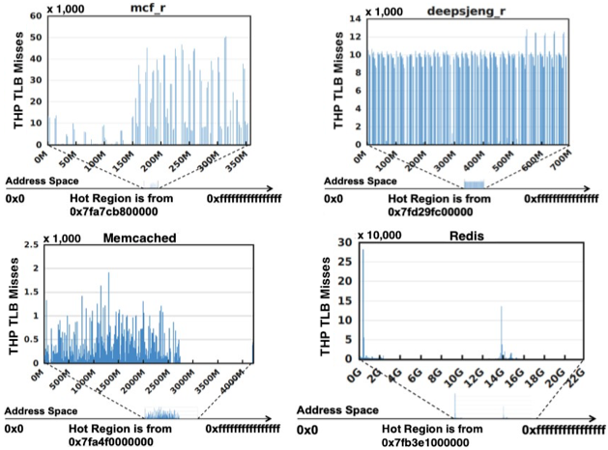
HyMM – The Results
Monitoring TLB misses to figure out the Hot regions in which (huge) pages are accessed frequently.
mcf
deepsjeng
Memcached
Redis
An effective method as:
1. Cold pages have only a small num. of TLB misses, but Hot pages have a lot.
2. Page’s TLB entry has the almost equal opportunity to be swapped out. [B. Gras, et al, in USENIX Security 2018]
Notes:
Monitoring TLB misses to figure out the hot regions is an effective approach. Here are several results including both desktop level and cloud level workloads.
In our practice, cold pages only have a small number of TLB misses, but hot pages have a lot.
One may assume that the hot pages will be kept in TLB and thus do not incur tlb misses. However, modern architecture does not allow this design in order to defend the side-channel attack.
Thus, only a very small number of pages belong to this type, but we still have an approach to detect them.

Slide 33
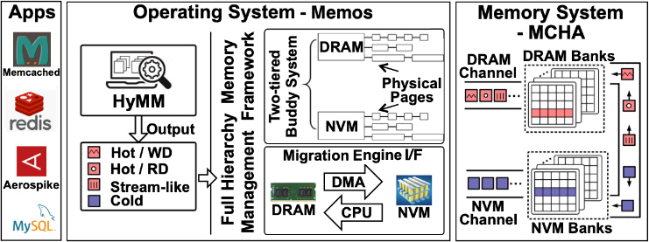
Memos: Hybrid Memory Management
We design Memos – a hybrid memory management mechanism in OS kernel for the new memory hierarchy
New Features: (1) Two-tiered Buddy System; (2) Hybrid DMA-CPU combined page migration approach; (3) HyMM.
Lei Liu, et al, Hierarchical Hybrid Memory Management in OS for Tiered Memory, In IEEE TPDS, 2019
Notes:
Our recent work designs a system that manages the hybrid memory system, in which NVM is located beside the DRAM in unified memory address space.
It has several new features: (1) two tiered buddy system, one is for NVM and the other is for DRAM. And the memory page-level granularity can be configured. For example, we can enable huge page for NVM.

Slide 34
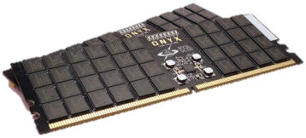
Memos – How it works?
HyMM
1. Data-Memory Mapping across memory hierarchy
Memos
2. Cache Management for different memories
OS
3. Hybrid data migration – DMA and OS operation
Cache
Data for DRAM
Data for NVM
DRAM Channel
NVM Channel
Lifetime: 34x
Energy: 29～82%
DMA
(un)locked
Software Page
Migrate

Slide 35
More NVM brings higher performance!
Our New Approach is with high efficient!

Slide 36
Topic 3: Leveraging ML to Enhance Resource Scheduling for Microservices in Cloud Environments

Slide 37
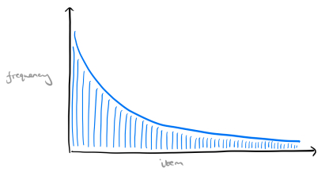
Time changes – Microservices have been dominating in cloud.
Tail Latency
QoS Violations
Notes:
Time changes. The cloud environments now have lots of microservices. They work together to provide services to end users. For QoS, if you put each microservice on a specific server, you will have ideal QoS, but it waste money, thus it is impossible.
So we have to co-locate them on servers. Then, the problem becomes to how to design a good scheduling mechanism to provide high quality services.

Slide 38
New Resource Scheduling Approaches are Expected!
(1) Heuristic/perf. model-based scheduling might not handle users’ diverse requirements in a timely fashion.
(2) Failing to have an optimal schedule for microservices by simultaneously considering a combination of multiple resources – core counts, LLC ways and bandwidth usage.
(3) Scheduling overheads are significant.
CPU
LLC
B/W
Notes:
The existing schedulers do not work well in new cases. They often employ heuristic-based scheduling approaches. But, they do not perform well in handling the users’ diverse requirements in a timely fashion. And, they always fail to have an optimal schedule for microservices by considering a combination of multiple resources at the same time. For example, plz look at this figure, microservices incur contentions at cores, cache and bandwidth at the same time.
I myself design resource scheduler for many years, and I find that it is very hard to schedule resources that are interactive with each others.

Slide 39
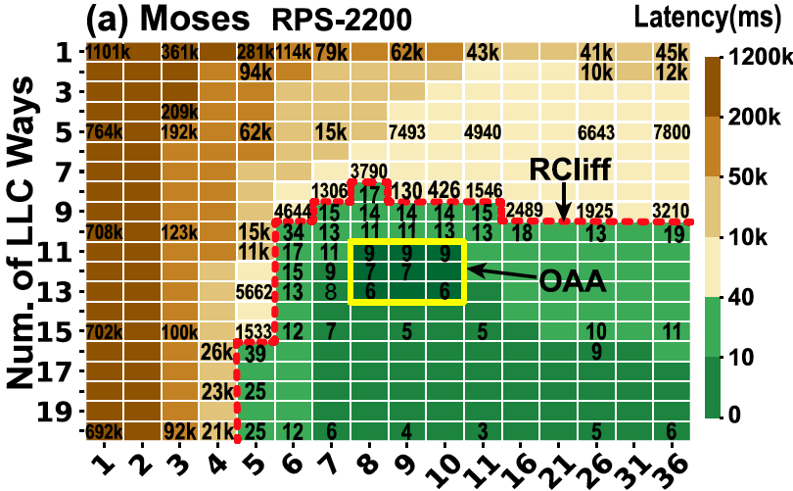
Features need to be considered for scheduling microservices
Num. of Cores
Key Observations:
“Resource Cliff” → Incurs significant performance changes
Opt. Allocation Area (OAA) → Better QoS
Notes:
In terms of microservices, we find they often have several new features that should be considered in scheduling. For one thing, widely used microservices often exhibit resource cliff. Plz have a look at the figure, the QoS suffers a seriously slowdown if only one core is deprived of. And, you can obverse the similar phenomenon for LLC ways – for a specific number of cores, the performance will go down if only one cache way is deprived of.
Moreover, we also observe that the application has optimal allocation area, which indicates that the better performance when resource allocation is in that way.

Slide 40
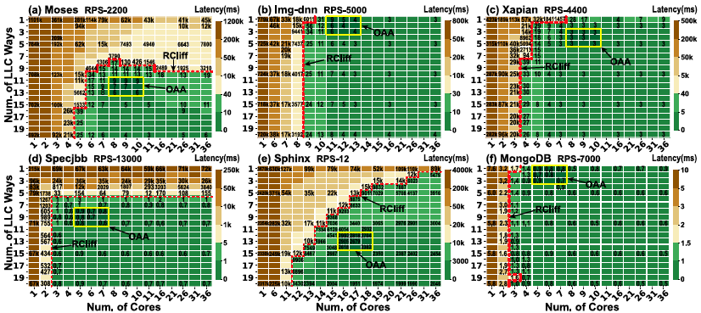
Many microservices exhibit “RCliff”, though some of them only have “RCliff” for one resource
“RCliff” exists for diverse cases – Request Per Second (RPS)
Notes:
We investigate many commonly used services, we find the RCliff always exist. Some of them exhibit cliff phenomenon for LLC, some of them exhibit cliff for cores, and some of them exhibit both of them. Furthermore, we change the request per second – the user demands – and find the RCliff always exhibit, though it may change according to different RPS.

Slide 41
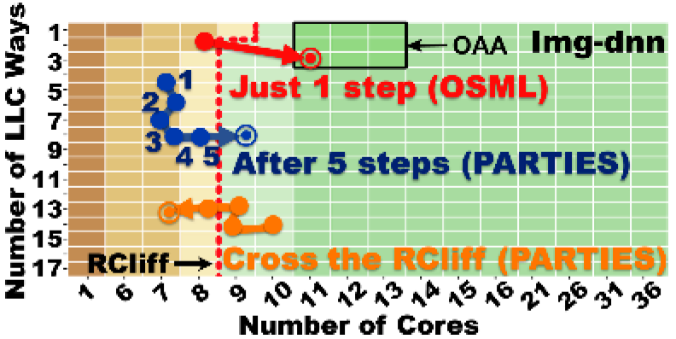
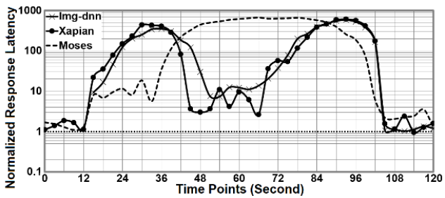
Real Cases Comparisons for different Schedulers
Heuristic based scheduling cannot perform well - The “Trial and Error” Model is not a good way for scheduling many microservices.
Notes:
In such cases, the previous heuristic based scheduling is not aware of this, and their “trial and error” mode often causes “falling off the cliff”.
These figures show the examples. The heuristic based scheduling algorithm tries different allocation policies for diverse resources, and test if the policy can bring ideal QoS. During the scheduling, if a little bit of resource is deprived around the RCliff, the performance will suffer a significant unpredictable slowdown. And, the previous scheduling often search in the base of the cliff, and have a hard time to get out, thus the services always suffer a slowdown.

Slide 42
OSML – Using ML technologies for resource scheduling
Challenges:
1. Scare training data → inaccurate inference results
2. Lack of clear abstraction of ML models → scheduler is hard to design
3. Lack of a clarity in software stack → control/data flow is unclear
Our Solutions:
1. 2-billion samples from 11 typical microservices - 72,776,880 cases
2. Design 3 models employing 2 MLP models and a reinforcement learning model – Finding Opt. Allocation Area, Balancing QoS and Resources, and Handling the unseen changes on the fly.
3. We put these models between user-level and OS and do not modify OS heavily.
Notes:
Our solution is using ML technologies for resource scheduling.

Slide 43
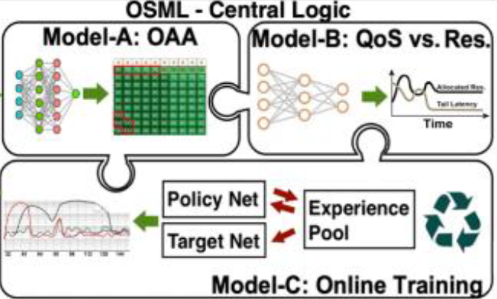
Model-B: Trading QoS for Resources; Trading Resources for QoS
3-layer multilayer perceptron (MLP)
Achieving global QoS requirement
Model-A: Finding OAA
3-layer multilayer perceptron (MLP)
Avoiding RCliff
Model-C: Handling unseen cases on the fly
- DQN; - Learning online
Notes:
For example, model-B predicts how many resources could be deprived of from a microservice with allowable QoS slowdown. And predict how many resources should be allocate to it to achieve the QoS requirement.

Slide 44
Data Collection and Model Training (1) – diverse workloads
Notes:
The data collection process takes over 9 months, involving 11 widely used microservices on modern platform. And, we also test diverse user demands. And we collect the performance trace for them.

Slide 45
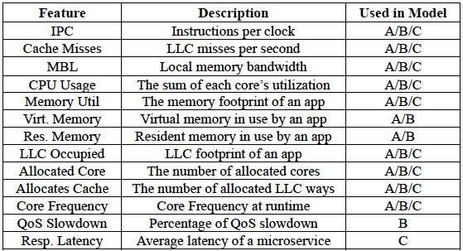
Data Collection and Model Training (2) - 72,776,880 cases
Notes:
Here we show the parameters involved in our data collection process.
For example, we test a large amount of cases for thread-core-LLC ways mapping, and test a large amount of cases for QoS changes. During the process, we label the corresponding ideal resource allocation policy.
More details can be found in our recent technical report.
In general, we think that our training data covers the typical cases. Our data collection process is still undergoing. So I think our model can be with good accuracy.

Slide 46
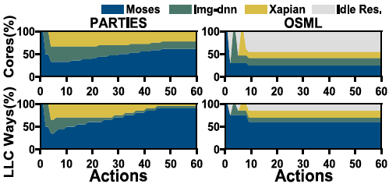
- 1/5 scheduling overheads of previous heuristic-based approaches
- Avoiding RCliff → do not incur significant QoS spiking
- Achieving better solutions within low overheads
- Saving cores and cache ways → saving banquet and
energy
In practice, our approach can achieve the OAA quickly, and also can save resource.
Notes:
In practice, our approach can achieve the OAA quickly, and also can save resource.

Slide 47
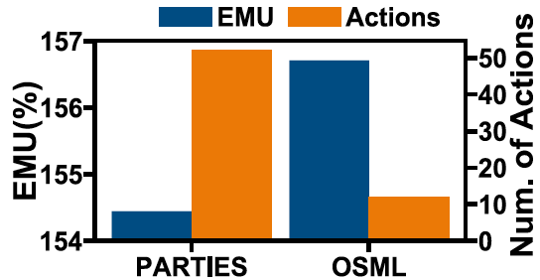
- OSML effectiveness for scheduling 4 microservices that include Masstree, Specjbb, Xapian, and MongoDB (with 50% of maximum load – RPS-5000 – in the background). We observe that OSML can support a higher percentage of load (shown in highlighted cells in (c)). (d) shows Oracle cases. We can see that OSML behaves similarly to Oracle. For these exceptional cases, it can also support 90% of Oracle, e.g., the highlighted cells in (d), in which Xapian is with 100% of its max loads.
- To achieve better solutions, OSML’s scheduling actions are only 1/5 of state-of-the-art scheduler, on average, bringing low scheduling overhead. Moreover, OSML helps to achieve higher EMU, which are measured by the response latency of microservices and the max aggregated load of all collocated microservices.

Slide 48
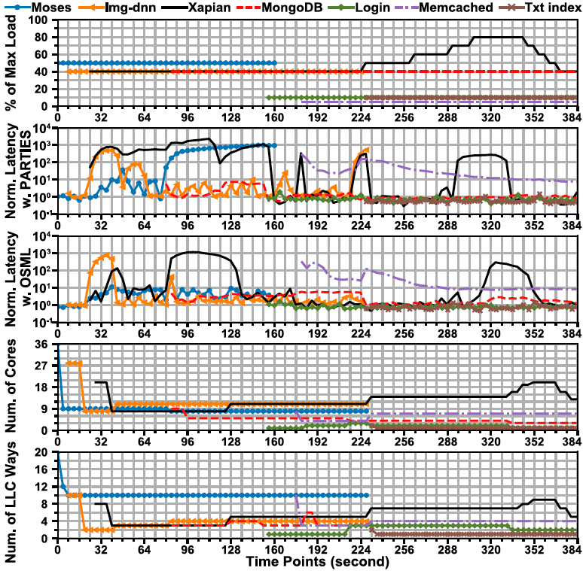
Previous approach has unpredictable QoS
Violations.
OSML quickly detects it and adjusts the resource allocation policies; thus, benefitting the QoS,
providing more stable QoS than previous efforts.

Slide 49
Conclusions
The technical evolutions for memory partitioning approaches.
Hybrid memory management in OS for systems using NVM-DRAM.
Next Generation OS - Leveraging ML to build resource scheduling mechanisms.
For more details, please refer to the Sys-Inventor Lab’s web page.
http://www.escience.cn/people/LiuLei2010ict/index.html
Thank you!

